Slide 1
welcome to
COMP 2691
Intermediate Windows Application Development in .NET
Week 1
Input / Output (Part One)
Amir Ahani, M.Sc. + MBA
Microsoft Certified Solution Developer (MCSD .NET)
Microsoft Certified Database Administrator (MCDBA)
Email: amirahani@gmail.com
<number> of 28
Notes:
COMP2690 Windows Application Development with C#

Slide 2
Today…
About the course
Files and Directories
  What are the File System Classes?
  FileSystemInfo – FileInfo – DirectoryInfo – DriveInfo Classes (Informational)
  File – Directory – Path Classes (Utility)
  FileSystemWatcher Class
Lab: Enumerate Files and Watch for Changes
<number> of 28
Notes:
COMP2690 Windows Application Development with C#

Slide 3
About the Course
Outline
MyBCIT Email
ShareIN/OUT
MyBCIT
Coding standards
BCIT Library (24*7)
MSDN Online
C# Useful Links
Required Software
Visual C# 2008 Express (Visual Studio) *
Required
.NET Software Development Kit (SDK)
Optional
.NET Redistributable (.NET Runtime)
Optional
Shared Source Common Language Infrastructure (SSCLI)
Optional
* You may of course use any edition of Visual Studio 2008
<number> of 28
Notes:
COMP2690 Windows Application Development with C#

Slide 4
What are the File System Classes?
  Inside the System.IO namespace are a set of classes used to
  navigate and manipulate files, directories, and drives. The file system
  classes are separated into two types of classes: informational and
  utility. Most of the informational classes derive from the
  FileSystemInfo base class. These classes expose all the system
  information about file system objects—specifically, files, directories,
  and drives. These classes are named FileInfo and DirectoryInfo. In
  addition, the DriveInfo class represents a drive in the file system, but
  although it is still an informational class, it does not derive from
  the FileSystemInfo class because it does not share the common sorts
  of behavior (for example, you can delete files and folders, but not
  drives).
<number> of 28
Notes:
COMP2690 Windows Application Development with C#

Slide 5
What are the File System Classes? (cont’d)
  The utility classes provide static methods (or shared ones for Visual
  Basic) to perform certain operations on file system objects such as
  files, directories, and file system paths. These utility classes include
  the File, Directory, and Path classes.
<number> of 28
Notes:
COMP2690 Windows Application Development with C#

Slide 6
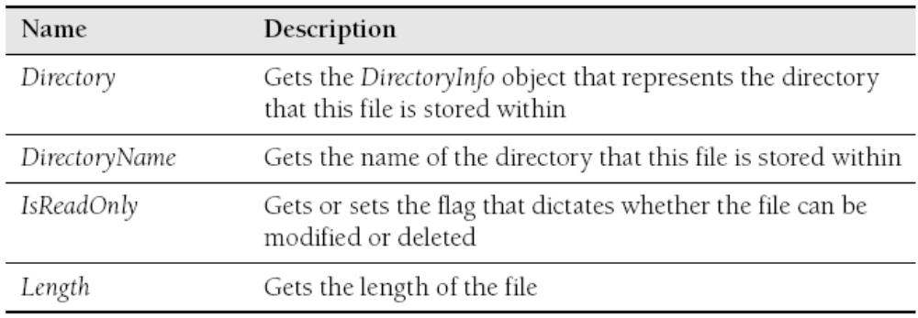
FileInfo Class
  The FileInfo class provides the basic functionality to access and
  manipulate a single file in the file system.
  FileInfo Properties:
<number> of 28
Notes:
COMP2690 Windows Application Development with C#

Slide 7
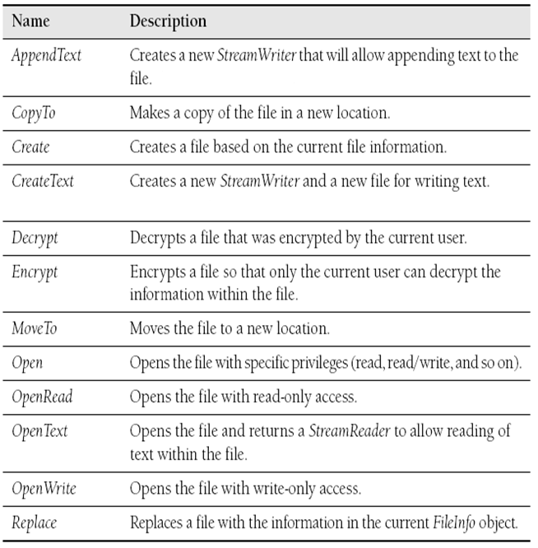
FileInfo Class
  FileInfo Methods:
<number> of 28
Notes:
COMP2690 Windows Application Development with C#

Slide 8
FileInfo Class
FileInfo Examples:
  How to Get Information about a File
  FileInfo ourFile = new FileInfo(@"c:\boot.ini ");
  if (ourFile.Exists)
  {
  Console.WriteLine("Filename : {0}", ourFile.Name);
  Console.WriteLine("Path : {0}", ourFile.FullName);
  }
  How to Copy a File
  FileInfo ourFile = new FileInfo(@"c:\boot.ini");
  ourFile.CopyTo(@"c:\boot.bak");
<number> of 28
Notes:
COMP2690 Windows Application Development with C#

Slide 9
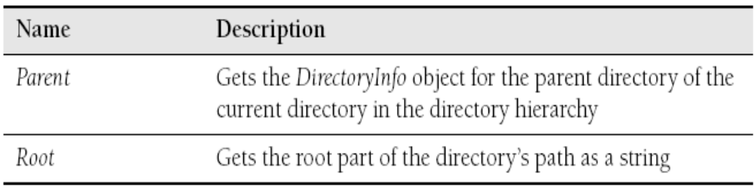
DirectoryInfo Class
  The DirectoryInfo class provides the basic functionality to
  access and manipulate a single directory in the file system.
  DirectoryInfo Properties:
<number> of 28
Notes:
COMP2690 Windows Application Development with C#

Slide 10
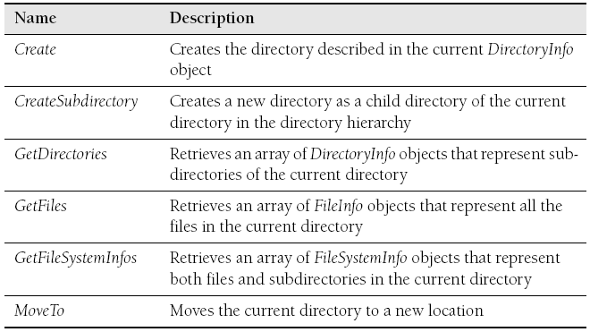
DirectoryInfo Class
  DirectoryInfo Methods:
<number> of 28
Notes:
COMP2690 Windows Application Development with C#

Slide 11
DirectoryInfo Class
DirectoryInfo Example:
  How to Enumerate Files in a Directory
  DirectoryInfo ourDir = new DirectoryInfo(@"c:\windows");
  Console.WriteLine("Directory: {0}", ourDir.FullName);
  foreach (FileInfo file in ourDir.GetFiles())
  {
  Console.WriteLine("File: {0}", file.Name);
  }
<number> of 28
Notes:
COMP2690 Windows Application Development with C#

Slide 12
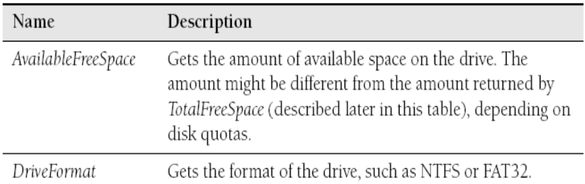
DriveInfo Class
The DriveInfo class provides the basic functionality to access
  and manipulate a single directory in the file system.
  DriveInfo Properties:
<number> of 28
Notes:
COMP2690 Windows Application Development with C#

Slide 13
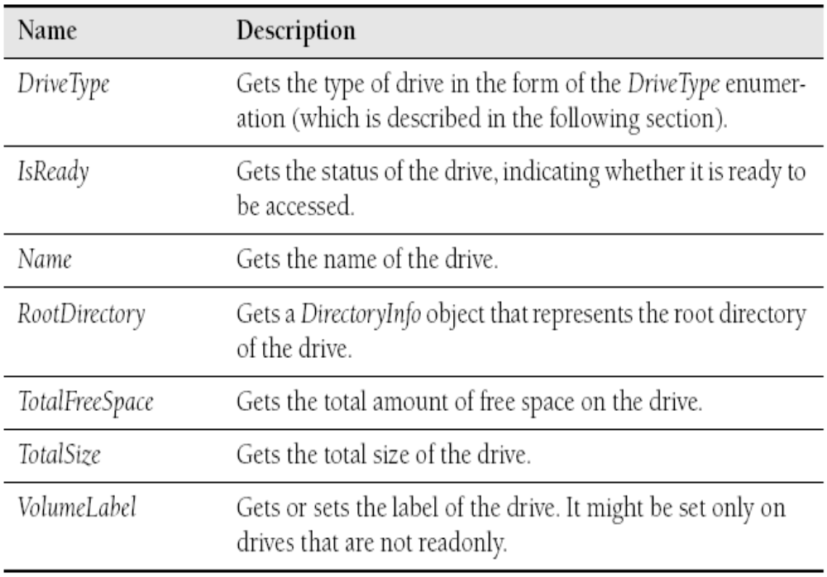
DriveInfo Class
  DriveInfo Properties:
<number> of 28
Notes:
COMP2690 Windows Application Development with C#

Slide 14
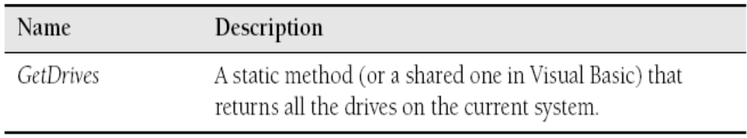
DriveInfo Class
  DriveInfo Method:
<number> of 28
Notes:
COMP2690 Windows Application Development with C#

Slide 15
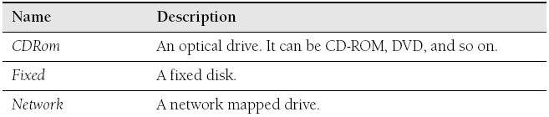
DriveInfo Class
DriveType Enumeration
  The DriveType enumeration provides the possible types of
  drives that can be represented by a DriveInfo object.
  DriveType Members:
<number> of 28
Notes:
COMP2690 Windows Application Development with C#

Slide 16
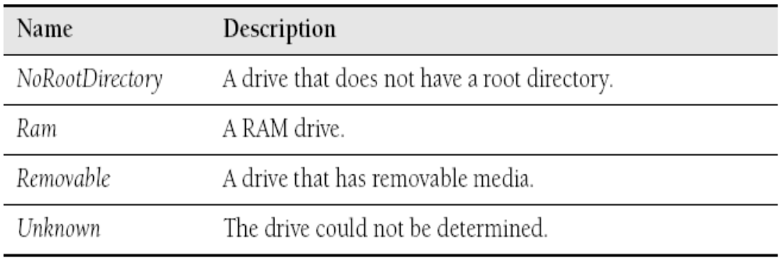
DriveInfo Class
  DriveType Members:
<number> of 28
Notes:
COMP2690 Windows Application Development with C#

Slide 17
DriveInfo Class
DriveInfo Example:
  How to Enumerate Drives
  DriveInfo[] drives = DriveInfo.GetDrives();
  foreach (DriveInfo drive in drives)
  {
  Console.WriteLine("Drive: {0}", drive.Name);
  Console.WriteLine("Type: {0}",
  drive.DriveType);
  }
<number> of 28
Notes:
COMP2690 Windows Application Development with C#

Slide 18
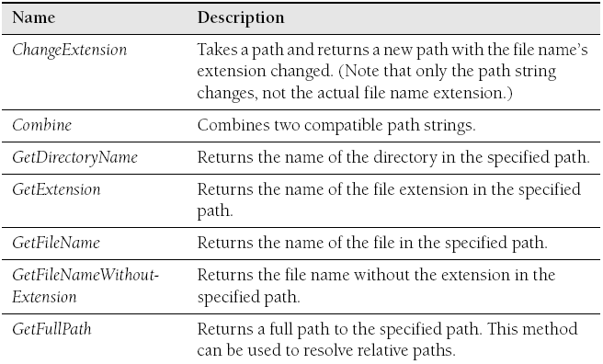
Path Class
  The Path class provides methods for manipulating a file system
  path.
  Path Methods:
<number> of 28
Notes:
COMP2690 Windows Application Development with C#

Slide 19
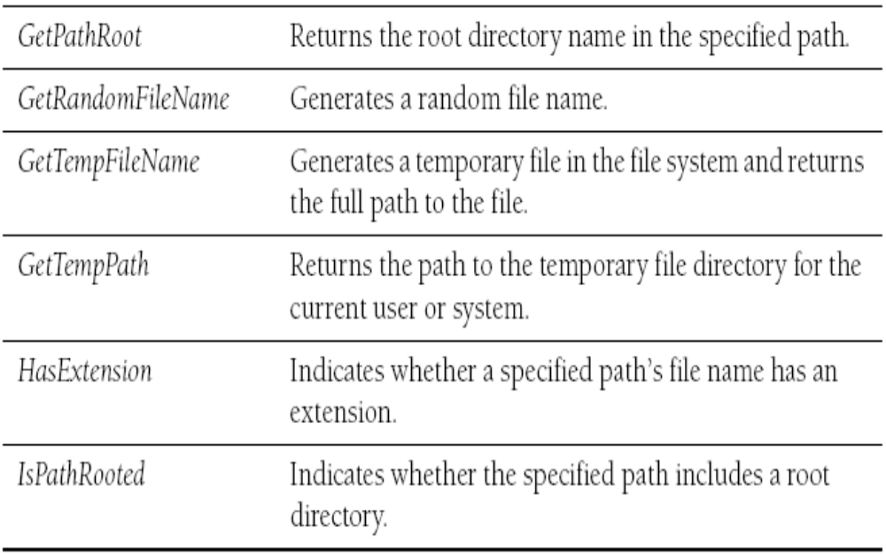
Path Class
  Path Methods:
<number> of 28
Notes:
COMP2690 Windows Application Development with C#

Slide 20
Path Class
Path Example:
  How to Change a File Extension
  string ourPath = @"c:\boot.ini";
  Console.WriteLine(ourPath);
  Console.WriteLine("Ext: {0}", Path.GetExtension(ourPath));
  Console.WriteLine("Change Path: {0}",
  Path.ChangeExtension(ourPath, "bak"));
<number> of 28
Notes:
COMP2690 Windows Application Development with C#

Slide 21
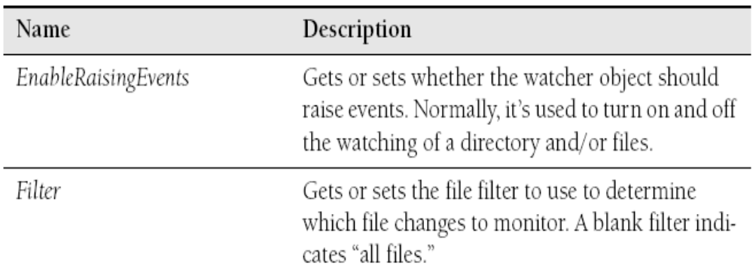
FileSystemWatcher Class
  The FileSystemWatcher class provides methods for monitoring file system directories for changes.
  FileSystemWatcher Properties:
<number> of 28
Notes:
COMP2690 Windows Application Development with C#

Slide 22
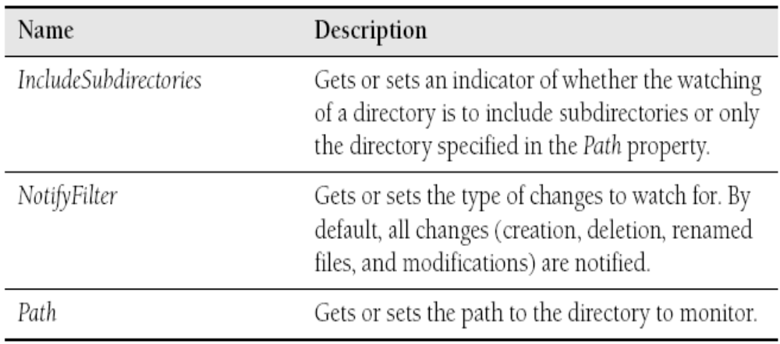
FileSystemWatcher Class
  FileSystemWatcher Properties:
<number> of 28
Notes:
COMP2690 Windows Application Development with C#

Slide 23
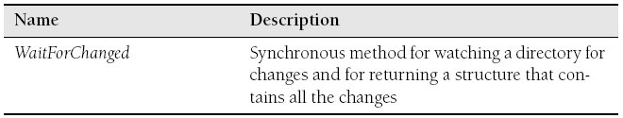
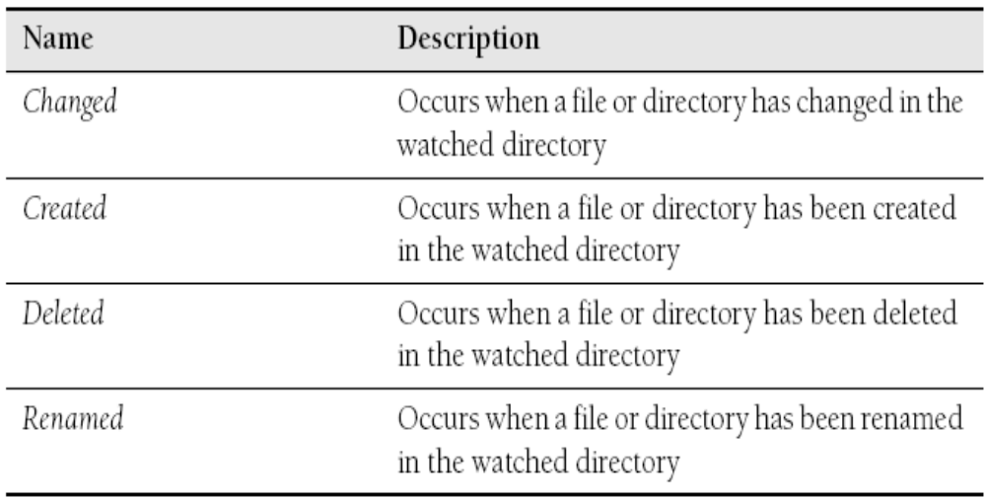
FileSystemWatcher Class
  FileSystemWatcher Method:
  FileSystemWatcher Events:
<number> of 28
Notes:
COMP2690 Windows Application Development with C#

Slide 24
FileSystemWatcher Class
Exmple: FileSystemWatcher
  How to Monitor a Directory for Changes (Created / Deleted)
  FileSystemWatcher watcher = new FileSystemWatcher();
  watcher.Path = @"c:\";
  // Register for events
  watcher.Created += new FileSystemEventHandler(watcher_Changed);
  watcher.Deleted += new FileSystemEventHandler(watcher_Changed);
  // Start Watching
  watcher.EnableRaisingEvents = true;
  // Event Handler
  static void watcher_Changed(object sender, FileSystemEventArgs e)
  {
  Console.WriteLine("Directory changed({0}): {1}", e.ChangeType,
  e.FullPath);
  }
<number> of 28
Notes:
COMP2690 Windows Application Development with C#

Slide 25
FileSystemWatcher Class
Example: FileSystemWatcher
  How to Monitor a Directory for Changes (Renamed)
  FileSystemWatcher watcher = new FileSystemWatcher();
  watcher.Path = @"c:\";
  // Register for events
  watcher.Renamed += new RenamedEventHandler(watcher_Renamed);
  // Start Watching
  watcher.EnableRaisingEvents = true;
  // Event Handler
  static void watcher_Renamed(object sender, RenamedEventArgs e)
  {
    Console.WriteLine("Renamed from {0} to {1}", e.OldFullPath, e.FullPath);
  }
<number> of 28
Notes:
COMP2690 Windows Application Development with C#

Slide 26
Lab: Enumerate Files and Watch for Changes
In this lab, you will enumerate through the files of a folder and then watch to see whether any files have changed.
using System.IO;
class Program
{
static void Main(string[] args)
{
DirectoryInfo dir = new DirectoryInfo(Environment.CurrentDirectory);
ShowDirectory(dir);
}
static void ShowDirectory(DirectoryInfo dir)
{
foreach (FileInfo file in dir.GetFiles())
{
Console.WriteLine("File: {0}", file.FullName);
}
// Go through subdirectories recursively
foreach (DirectoryInfo subDir in dir.GetDirectories())
{
ShowDirectory(subDir);
}
}
}
<number> of 28
Notes:
COMP2690 Windows Application Development with C#

Slide 27
Lab: Enumerate Files and Watch for Changes
using System.IO;
namespace ConsoleApplication1
{
class Program
{
static void Main(string[] args)
{
FileSystemWatcher watcher = new FileSystemWatcher(Environment.SystemDirectory);
watcher.Filter = "*.txt";
watcher.IncludeSubdirectories = true;
watcher.NotifyFilter =NotifyFilters.Attributes | NotifyFilters.Size;
watcher.Changed += new FileSystemEventHandler(watcher_Changed);
// Start the Events
watcher.EnableRaisingEvents = true;
// Read for a keypress to exit the app
Console.Read();
}
static void watcher_Changed(object sender,FileSystemEventArgs e)
{
Console.WriteLine("Changed: {0}", e.FullPath);
}
}
}
<number> of 28
Notes:
COMP2690 Windows Application Development with C#

Slide 28
Summary
  The FileInfo, DirectoryInfo, and DriveInfo classes can
  be used to enumerate and inspect the properties of file
  system objects.
  The Path class can be used to interrogate a file system
  path and should be used instead of parsing the string
  manually.
  The FileSystemWatcher class can be used to monitor
  the file system for changes such as additions, deletions, and renamings.
<number> of 28
Notes:
COMP2690 Windows Application Development with C#

